Slide 1

Chapter 7
Disease, Illness, and Healing
Notes:
For a better classroom presentation flow, the order of some topics in this lecture outline differs slightly from the order of topics in the text and, where this occurs, some figures and tables are out of numerical order.

Slide 2
Learning Objectives
7.1 Describe the scope of ethnomedicine and how it has changed in recent times.
7.2 Explain the three major theoretical approaches in medical anthropology.
7.3 Recognize how globalization is affecting health, illness, and healing.

Slide 3
The Subfield of Medical Anthropology
The cross-cultural study of health and health problems
One of the fastest-growing areas of anthropology
Mainly part of cultural anthropology, but closely linked with the other fields, especially biological anthropology

Slide 4
Ethnomedicine (1 of 2)
7.1 Describe the scope of ethnomedicine and how it has changed in recent times.
Ethnomedicine is the study of cross-cultural health systems

Slide 5
Ethnomedicine (2 of 2)
All cultures have a “health system,” which includes:
  Perceptions and beliefs about the body
  Classifications of health problems
  Prevention measures
  Healing/healers

Slide 6
Perceptions of the Body
Cultures differ in how they define people’s bodies
  Perception of what a “body” is
  Perception of internal and external parts
  Separation of mind and body
  Attitudes toward death
  Attitudes toward surgery

Slide 7
Defining and Classifying
Health Problems (1 of 5)
No universal set of labels applies in all cultures
The disease/illness dichotomy

Slide 8
Defining and Classifying
Health Problems (2 of 5)
Some bases for labeling health problems:
  Source/place of origin
  The vector, means of transmission
  Affected body part
  Symptoms
  Combination of any of the above
  Example: Subanun categories of skin-related health problems

Slide 9
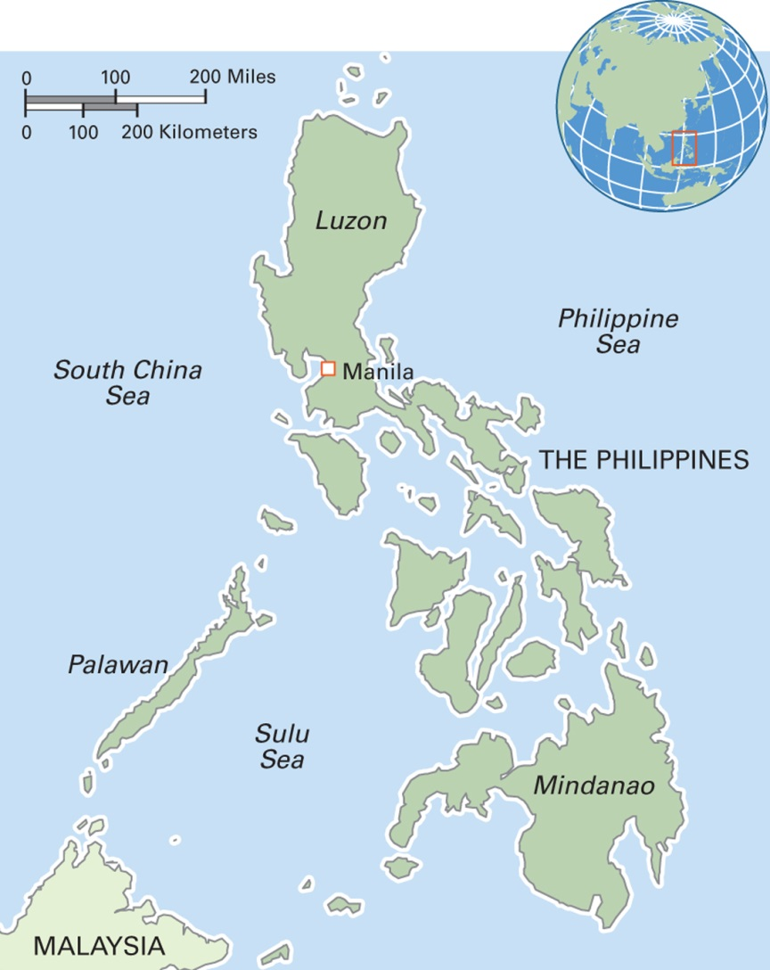
Map 7.2 The Philippines
Notes:
The Republic of the Philippines comprises an archipelago of over 7,000 islands, of which around 700 are populated. The population is 104 million, with two-thirds living on Luzon. The economy is based on agriculture, light industry, and a growing business-processing outsourcing (BPO) industry. Over 8 million Filipinos work overseas and remit more than $12 billion a year, a large part of the country’s economy. Although Filipino and English are the official languages, more than 170 languages are spoken. Literacy rates are high for both males and females. Many different ethnic groups live in the country, with Tagalog people constituting the largest proportion of 30 percent. The Philippines has the world’s third-largest Christian population, among which Roman Catholicism is predominant.

Slide 10
Defining and Classifying
Health Problems (3 of 5)
Culture-Specific Syndrome
  A health problem and set of symptoms associated with a particular culture
  Social factors often an underlying cause
  Biophysical symptoms may occur through somatization

Slide 11
Defining and Classifying
Health Problems (4 of 5)
Susto
  Found in Spain and Portugal
  Prevalent among Latino populations in the New World, especially the older generation
  No clear equivalent in English-language labels
  Case study in Oaxaca, Mexico, found that people suffering from susto have higher mortality rates (die earlier)

Slide 12
Defining and Classifying
Health Problems (5 of 5)
Early research in medical anthropology focused on CSSs of “the other”
Western cultures have CSSs too
Question: What is an example of a CSS on your campus?

Slide 13
Ethno-Etiologies (1 of 4)
Cross-cultural explanations for the causes of health problems and suffering
May focus on factors that are
  Natural/environmental
  Structural
  Psychological
  Supernatural

Slide 14
Ethno-Etiologies (2 of 4)
Multiple causalities in urban Brazil
  Study of the urban poor of Feira de Santana, a city in Bahia
  People have complex understanding of causality, depending on the affliction
  Sometimes a natural/environmental cause, sometimes a supernatural one, and sometimes an economic one: “People have many illnesses because they are poor”

Slide 15
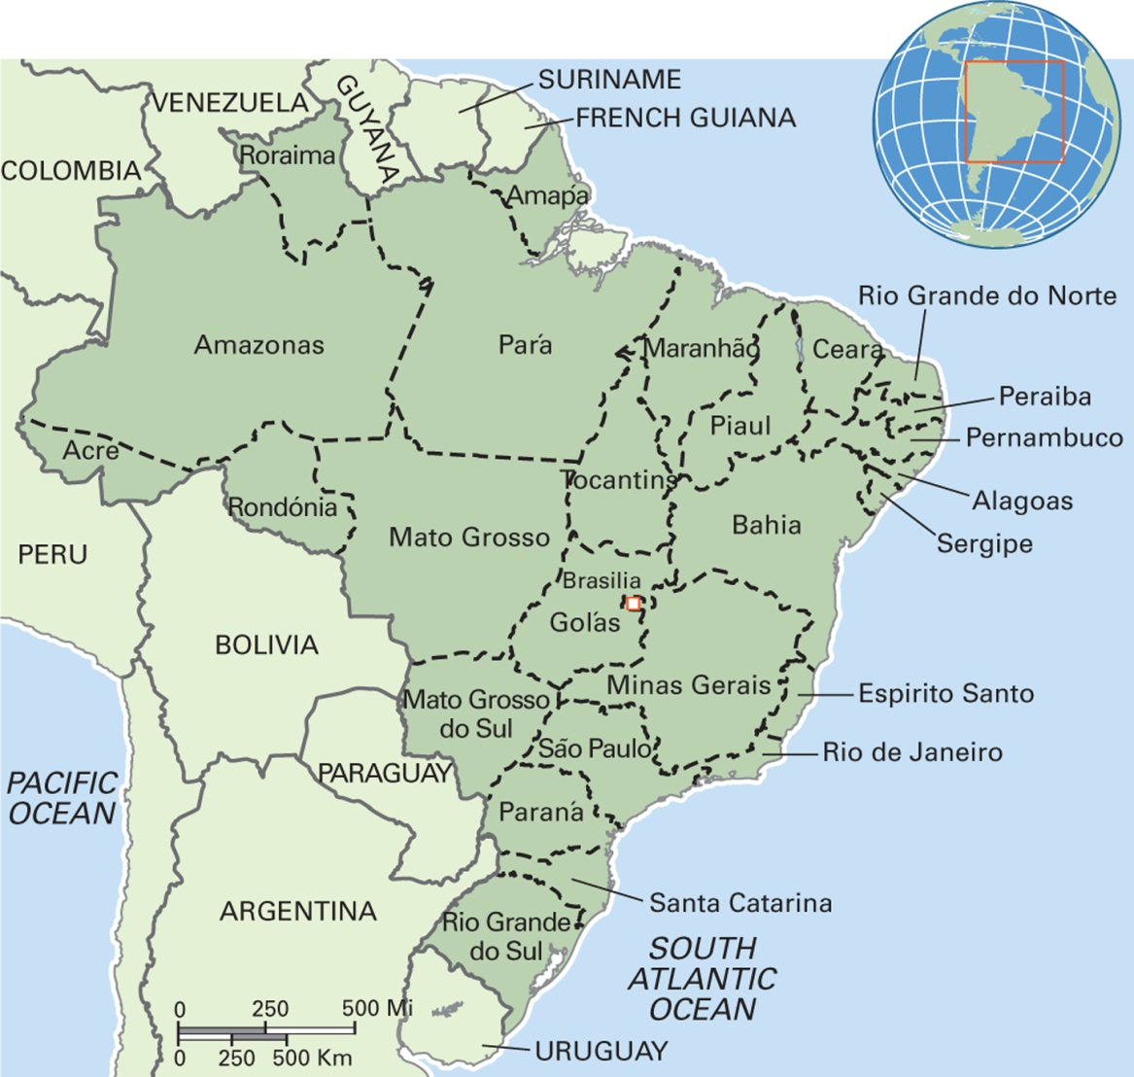
Map 7.1 Federative Republic of Brazil
Notes:
Brazil, a federation of 26 states, is the largest and most populous country in Latin America and the fifth largest worldwide. Its total population is about 200 million, and São Paulo, its largest city, has a population of 11 million. Brazil has one of the most extensive river systems in the world. The economy is based on manufacturing, mining, agriculture, and technology. For 150 years, Brazil has been the world’s largest producer of coffee. Ethnically, it comprises Europeans, Africans, Indians, and Asians. The official language is Portuguese. Roman Catholicism is the predominant religion, and Brazil has the largest Roman Catholic population in the world. Brazil has the world’s most extreme economic and social inequality, with many people, especially in the south and east, living in wealth and comfort while others living in the urban favelas (slums) and in the rural northeast experience extreme poverty, deprivation, and violence.

Slide 16
Ethno-Etiologies (3 of 4)
Structural suffering refers to health problems caused by war, famine, terrorism, forced migration, and poverty
Many examples, including sufriendo del agua (suffering from water) in Mexico

Slide 17
Ethno-Etiologies (4 of 4)
A different form of structural suffering is stigma
Stigma: A negative categorization of a person or group on the basis of some characteristic such as a disease or disability that causes the stigmatized person or group to feel shame and self-blame and to attempt to hide their condition

Slide 18
Prevention (1 of 4)
Different cultures have various forms of health protection
  Charms
  Spells
  Hygiene
Less-studied topic than health problems and healing

Slide 19
Prevention (2 of 4)
Awas is a common childhood health problem in Guatemala
  Children born with lumps under the skin, marks on the skin, or albinism
  Cause: Problems the pregnant woman experienced, such as eating unwanted food or having an unpleasant encounter
  Prevention: Keep pregnant women happy, protect them

Slide 20
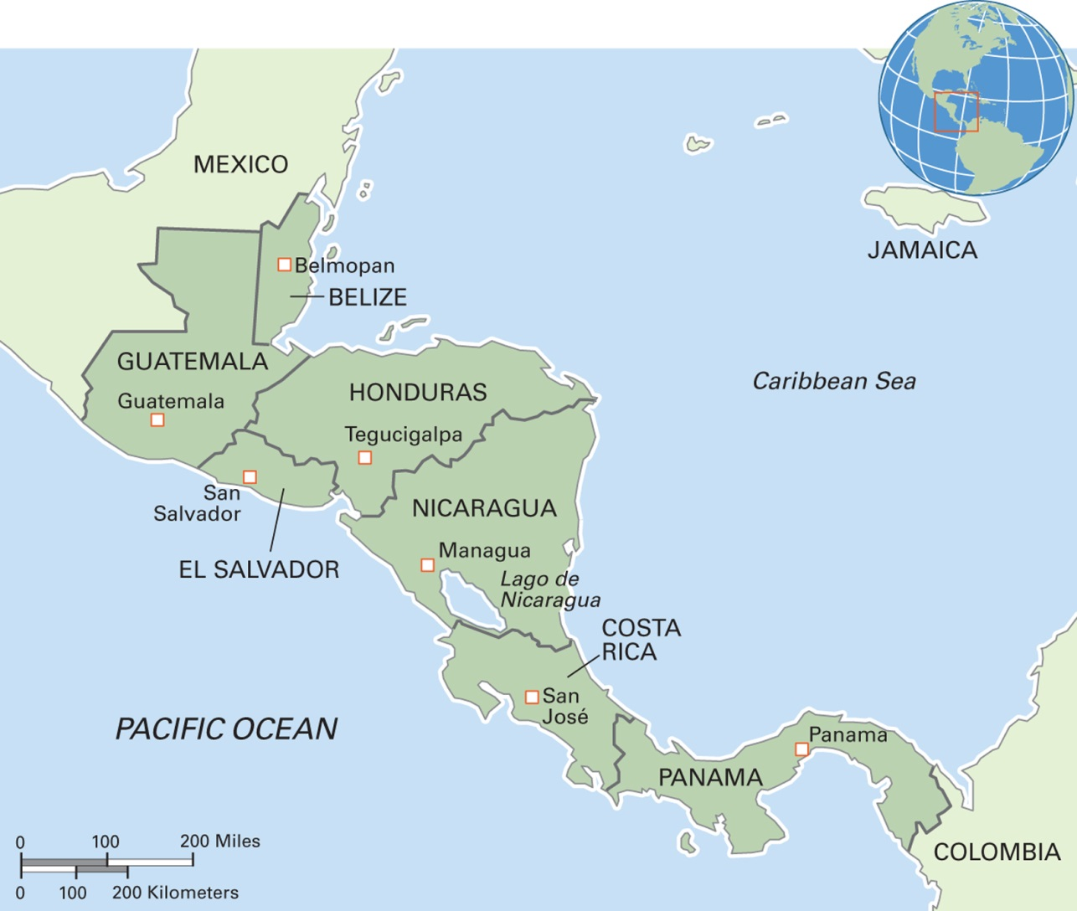
Map 7.3 Central America
Notes:
The countries of Central America share a similar geography as part of a long isthmus with a mountainous spine, active volcanoes, and rich soil. A federation that linked much of the region into the United Provinces of Central America existed from 1824 to 1838. The population of over 40 million people includes indigenous peoples and people of mixed indigenous and European ancestry. European colonialism has left a strong mark on the region, which is now heavily influenced by the United States and its interests in hemispheric economic and political domination. Bananas are the leading export crop of the region. For many decades, the region has been a source of labor migrants to the United States. Economic and personal insecurity in the region is driving continued migration flows, much of which is undocumented.

Slide 21
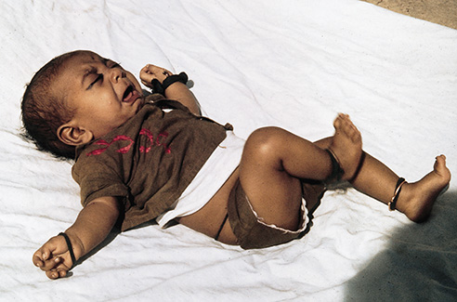
Prevention (3 of 4)
Ritual Health Protection
A Muslim baby in India wearing strings that have been blessed
Notes:
Throughout northern India, people believe that tying on ritually blessed strings provides protection from malevolent spirits. This Muslim baby has several protective strings.

Slide 22
Prevention (4 of 4)
Do such health-protection practices “work”?
  The question of “efficacy” (“working”) is complicated and will be discussed in the section on healing

Slide 23
Healing Ways (1 of 3)
Community Healing
  Example: the Ju/wasi
  Mobilization of community “energy” as key to cure
  All-night healing dances
  Open; everyone has access
Humoral Healing
    Example: Malaysia
    Based on balance among elements within the body
    Different foods/drugs have different “heating” or “cooling” effects

Slide 24
Healing Ways (2 of 3)
How does community healing “work” and how does humoral healing “work”?
Like much of Western biomedical healing, these approaches to healing “work” through the placebo or meaning effect:
  The afflicted gain social support in community healing and receive rules to follow in humoral healing

Slide 25
Healing Ways (3 of 3)
In community healing, the issue may be less focused on the need to cure the individual than to provide support for the community whose members have to face the loss of a valued and loved member
This kind of efficacy contrasts with the Western biomedical emphasis on healing an individual body, not a community

Slide 26
Healers (1 of 2)
All cultures recognize certain people as having special abilities to diagnose and treat health problems
  Midwives
  Bonesetters
  Shamans or shamankas
  Herbalists
  General practitioners
  Psychiatrists
  Nurses
  Acupuncturists
  Dentists
  Hospice care providers

Slide 27
Healers (2 of 2)
Criteria for becoming a healer:
  Selection
  Training
  Certification
  Professional image
  Expectation of payment

Slide 28
Healing Substances
Thousands of natural or manufactured substances are used as medicines for preventing or curing health problems
Phytotherapy
Minerals
“Radon spas”
Pharmaceutical medicines

Slide 29
Eye on the Environment (1 of 3)
Local Botanical Knowledge and Child Health in the Bolivian Amazon:
  Study of mothers’ knowledge of healing plants among the Tsimané
  Indigenous people of Bolivia’s Amazon region
  Foraging/horticultural livelihood

Slide 30
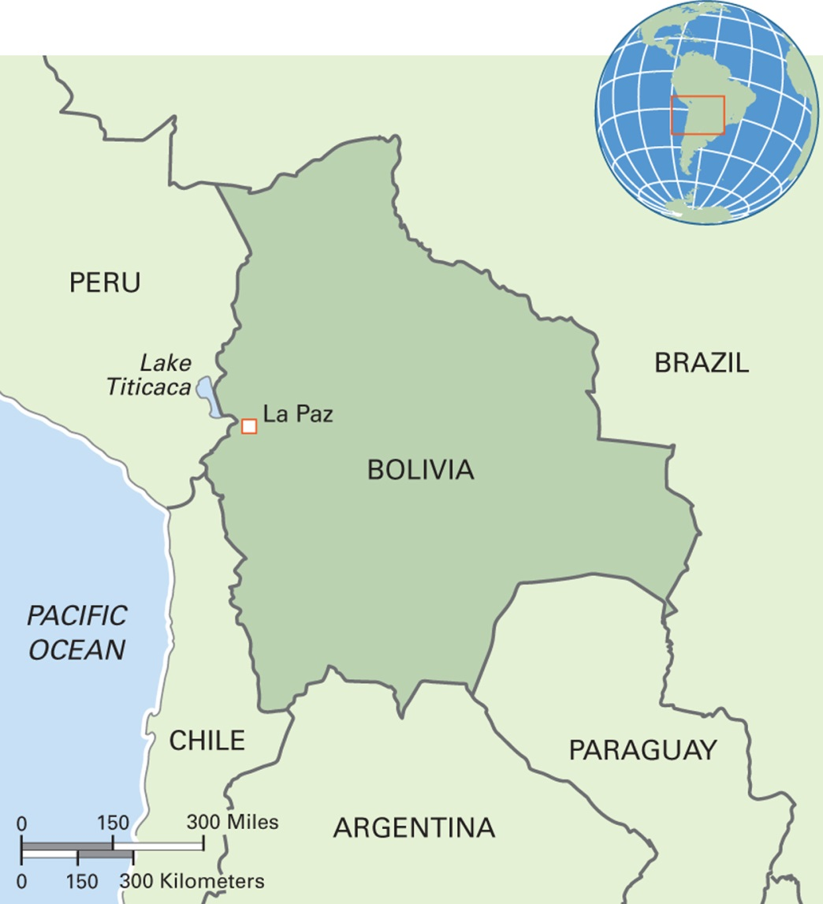
Map 7.4 The Republic of Bolivia
Notes:
Situated in the Andes Mountains, Bolivia is the lowest income country in South America, although it is rich in natural resources, including the second largest oil field in South America after Venezuela. The population of 10 million includes a majority of indigenous people of nearly 40 different groups. The largest are the Aymara (2 million) and Quechua groups (1.5 million). Thirty percent of the population is mestizo, of mixed descent, and 15 percent is of European descent. Two-thirds of the people are low-income farmers. The official religion is Roman Catholicism, but Protestantism is growing. Religious syncretism is prominent. Most people speak Spanish as their first language, although Aymara and Quechua are also common. Bolivia’s popular fiesta known as El carnival de Oruro is on UNESCO’s list of Intangible Cultural Heritage. In 2014, the government started building a mass-transit aerial cable system linking the capital city, La Paz, with its neighbor city, El Alto, the highest city in the world and the city in Latin America with the largest Indian population.

Slide 31
Eye on the Environment (2 of 3)
Findings:
  Strong relationship between mothers’ botanical knowledge and the health of their children
  More knowledgeable mothers provide healthier plant foods for their children (health care and prevention) and herbal treatments for illness
  Mother’s level of formal schooling had no relationship to her children’s health

Slide 32
Eye on the Environment (3 of 3)
Therefore: It is critical to protect access to and knowledge of plant resources by indigenous people
Food for Thought:
  What do you know about the effects on your health of particular plants that you eat?
  When you eat herbs, do you think about their health effects?

Slide 33
Three Theoretical Approaches
7.2 Explain the three major theoretical approaches in medical anthropology.
Ecological/Epidemiological Approach
Symbolic/Interpretivist Approach
Critical Medical Anthropology

Slide 34
Ecological/Epidemiological Approach
(1 of 3)
Studies the interaction of the environment and culture to explain the cause and spread of health problems

Slide 35
Ecological/Epidemiological Approach
(2 of 3)
Characteristics of the ecological/epidemiological approach:
  Tends to rely on quantitative data
  Applied emphasis: to provide findings for public health programs
  Considers issues such as infectious disease, urbanization, other “stressors”

Slide 36
Ecological/Epidemiological Approach
(3 of 3)
Application of the ecological/epidemiological approach to colonialism:
  Colonialism as a cause of death and affliction through contact and contagion
  Massive spread of infectious diseases
  Displacement, loss of livelihood
  Historical trauma
  Example: American Indians

Slide 37
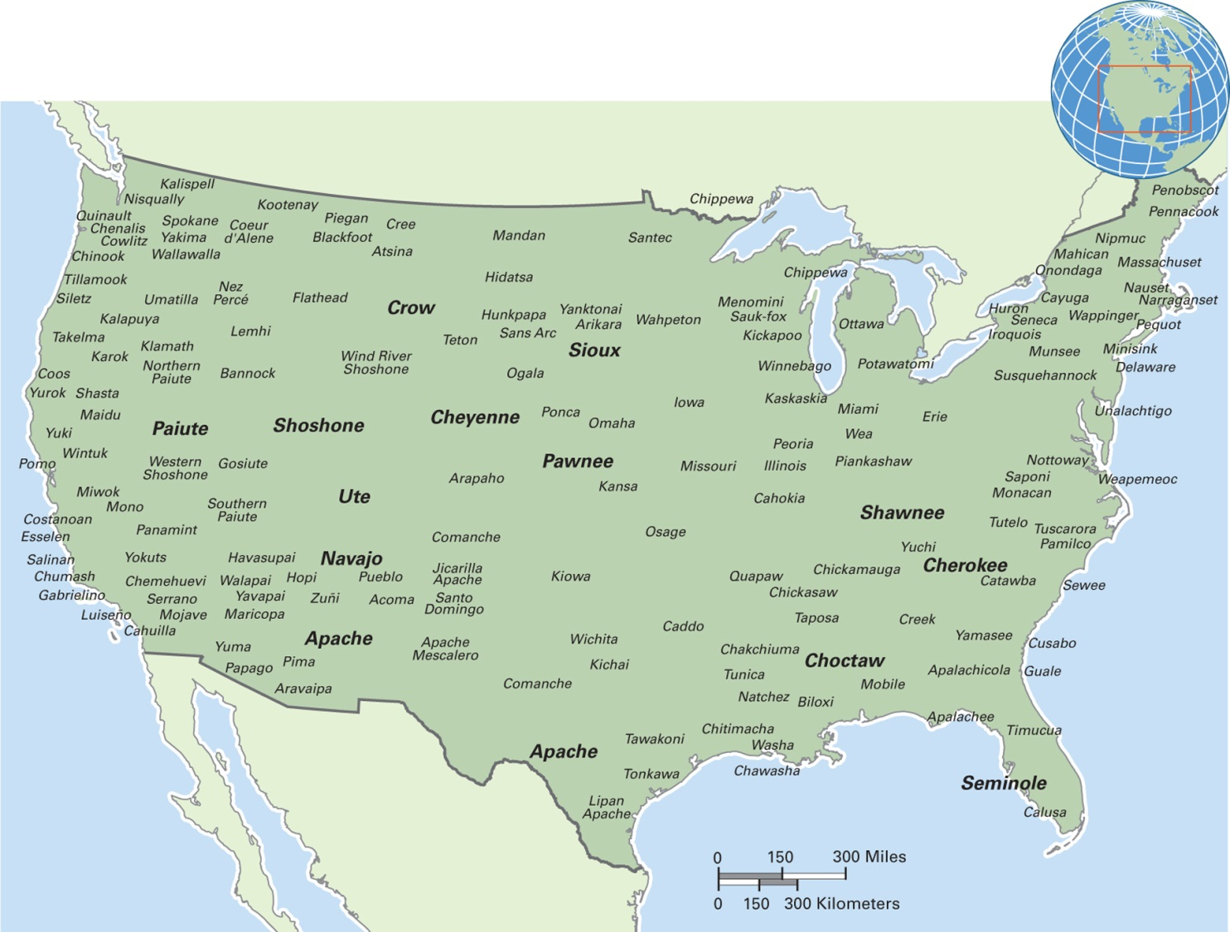
Map 7.5 Precolonial Distribution of Indian Tribes in the 48 United States
Notes:
Before the arrival of European colonialists, Indians were the sole occupants of the area. The first English settlers were impressed by their height and robust physical health.

Slide 38
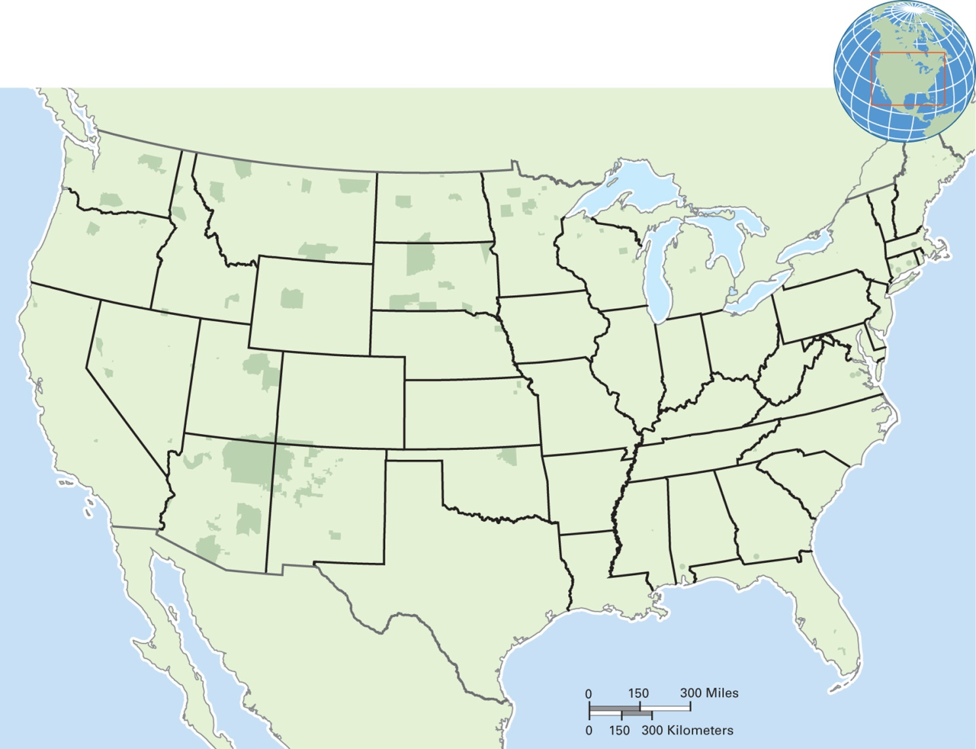
Map 7.6 Designated Reservations in the 48 United States
Notes:
Federal Indian reservations today make up a small percentage of the U.S. landmass. Reservations are allocated to “recognized tribes.” This map, however, does not show reservations designated by particular states. While such reservations are rare in the eastern states, they are extensive in several western states. Furthermore, this map under-represents the presence of American Indians since many nonrecognized tribes exist, and many Indians live off the reservations.

Slide 39
Symbolic/Interpretivist Approach
Focus on understanding illness and healing as symbolic and enacted as meaningful performance
Healing as providing symbolic meaning through the placebo effect, or meaning effect
Example: shamanic song among the Guna Indians to help in a difficult birth

Slide 40
Critical Medical Anthropology (1 of 2)
Focus on how economic and political power structures and inequality (structural suffering, structural violence) affect health and access to healing

Slide 41
Critical Medical Anthropology (2 of 2)
Issues in critical medical anthropology:
  Affliction is more a product of someone’s social position than “natural”
  Economic and political systems create health inequalities
  Poverty is a major cause of suffering, death
  Western doctor–patient relationships as a form of social control
  Western medicine emphasizes technology and is dehumanizing

Slide 42
Globalization and Change (1 of 2)
7.3 Recognize how globalization is affecting health, illness, and healing.
All aspects of health systems are changing
Afflictions are on the move
Healing techniques are on the move

Slide 43
Globalization and Change (2 of 2)
Globalization, health, and the role of anthropology in improving public health
  Topics include:
    Infectious diseases
    Diseases of development
    Medical pluralism
    Applied medical anthropology

Slide 44
Infectious Diseases (1 of 2)
Scientific advances in medicine and sanitation have reduced the threat of infectious disease
HIV/AIDS and SARS are spreading because of increased travel and migration

Slide 45
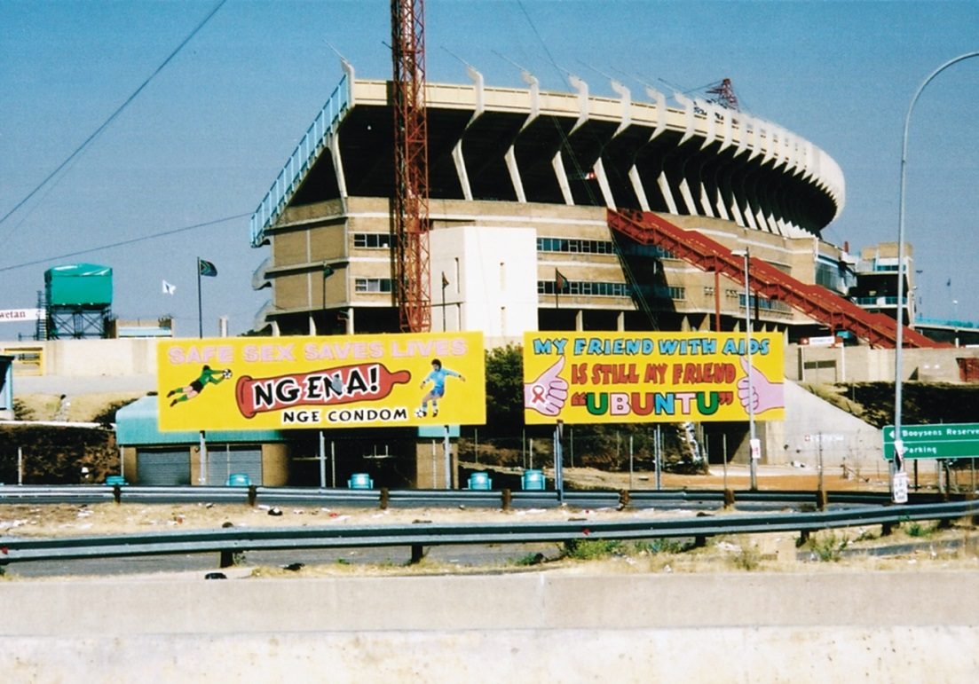
Infectious Diseases (2 of 2)
Example of HIV/AIDS
Billboards near Soweto, South Africa, promote condom use and seek to reduce the social stigma of the disease
Notes:
Social stigma often adds to the suffering of HIV/AIDS victims. The billboards, near Soweto in South Africa, promote condom use and seek to reduce social rejection and stigma.

Slide 46
Diseases of Development
Health problems caused or increased by development activities or by development itself:
  Schistosomiasis has increased in the tropical world as a result of dams and irrigation systems
  Obesity is on the rise in many developed countries

Slide 47
Medical Pluralism
Coexistence of multiple healing systems in one culture
Western biomedicine often displaces traditional practices, but sometimes coexists as one of several healing options
Example: the Sherpa of Nepal

Slide 48
Culturama: The Sherpa of Nepal (1 of 4)
Sherpa means “person”
150,000 Sherpa live in Nepal
Mixed economy involving animal herding, trade, small businesses, and farming (potatoes)
Men are increasingly employed as guides and porters for trekkers and climbers

Slide 49
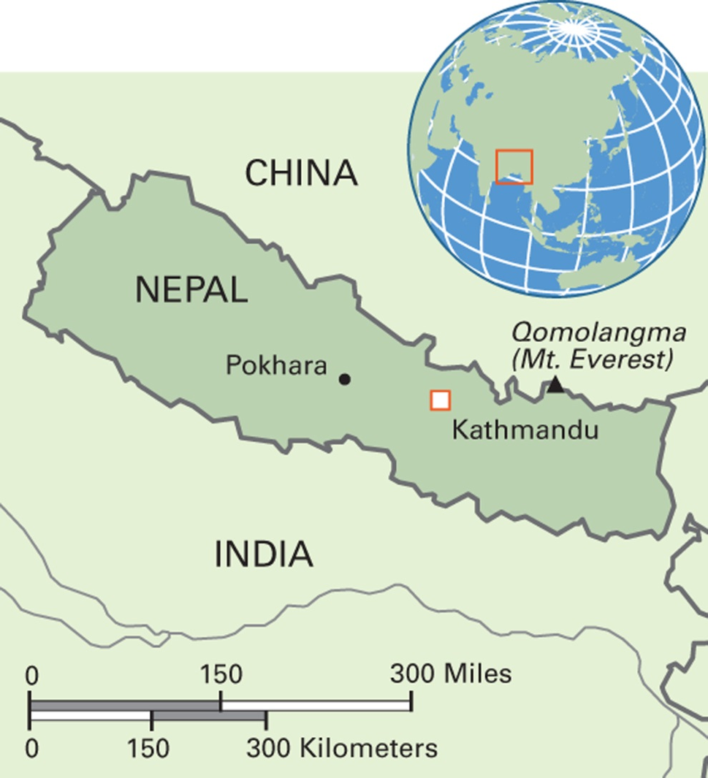
Map 7.7 Nepal
Notes:
The Kingdom of Nepal has a population of almost 30 million, a number double from that of 30 years ago. Most of its territory is in the Himalayas, and Nepal has 8 of the world’s 10 highest mountains.

Slide 50
Culturama: The Sherpa of Nepal (2 of 4)
Social Organization of the Sherpa
  18 separate lineages
  Marriage traditionally takes place outside of one’s birth lineage
  Status distinctions: “big people,” “middle people,” “small people”

Slide 51
Culturama: The Sherpa of Nepal (3 of 4)
Sherpa Religion
  Localized version of Tibetan Buddhism
  Connectedness of all beings
  Nature spiritualism: Many place names refer to deities

Slide 52
Culturama: The Sherpa of Nepal (4 of 4)
Contemporary challenges the Sherpa face:
  Tourism is a major economic opportunity and environmental/social threat—loss of cultural integrity, integration into uncertain wage economy
  Global warming: melting of glaciers, flooding

Slide 53
Conflicting Explanatory Models
The case of Mary, in American Samoa
  Example of serious miscommunication between biomedical practitioners and family of the child
  Diabetes misunderstood
  Fatality of the child
  Whose fault?

Slide 54
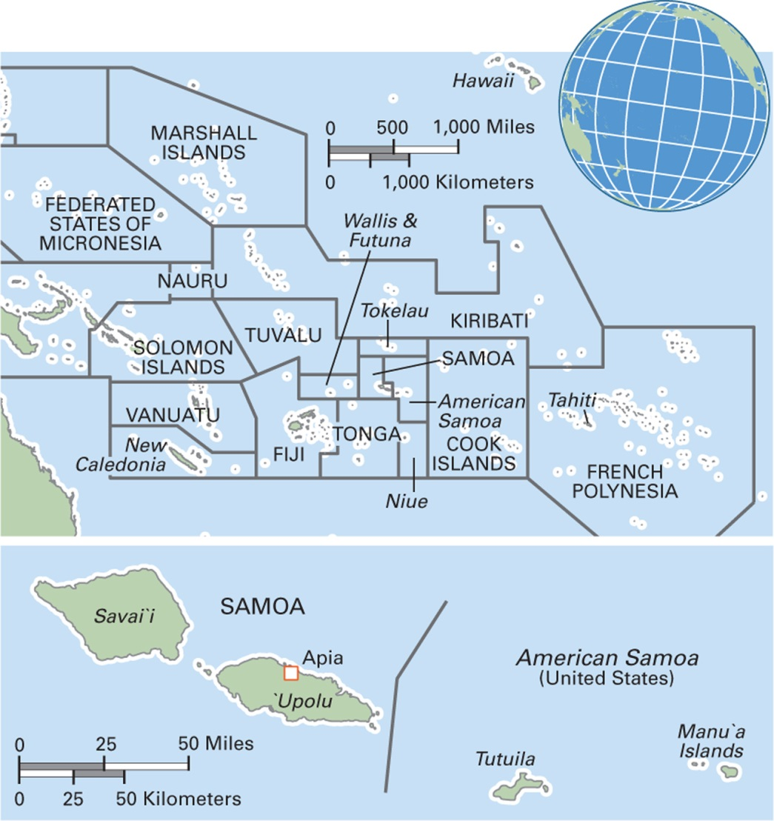
Map 7.8 Samoa and American Samoa
Notes:
Samoa, or the Independent State of Samoa, was known as German Samoa (1900–1919) and Western Samoa (1914–1997) until recognized by the United Nations as a sovereign country. Its population is around 190,000. American Samoa, or Amerika Samoa in Samoan English, is a territory of the United States with a population of about 55,000. During World War II, U.S. Marines in American Samoa outnumbered the local population and had a strong cultural influence. Unemployment rates are high, and the U.S. military is the largest employer.

Slide 55
Applied Medical Anthropology (1 of 3)
Research by applied/clinical medical anthropologists helps in:
  Multicultural doctor–patient understanding
  Making recommendations about culturally appropriate health programs
  Developing more effective cross-cultural health communication

Slide 56
Applied Medical Anthropology (2 of 3)
Cultural broker: Someone who is familiar with two cultures and can promote communication and understanding across them
Intercultural health: An approach in health that seeks to reduce the gaps between local and Western health systems in promoting more effective prevention and treatment of health problems

Slide 57
Applied Medical Anthropology (3 of 3)
Applied research by Robert Trotter
  Discovered reason for lead poisoning in a traditional “medicine”
  Devised an approach to help people replace azarcón with another medicine that is not harmful

Slide 58
Anthropology Works: Promoting Vaccination Programs in Developing Countries (1 of 2)
Vaccination programs often met with suspicion by the target population
Overall acceptance rates of vaccination are lower than expected
In India, people are suspicious that vaccinations are family planning programs
Population does not understand what they protect against

Slide 59
Anthropology Works: Promoting Vaccination Programs in Developing Countries (2 of 2)
Recommended changes in public health approach:
  Education campaigns for the public that address people’s concerns
  Education for public health specialists about the importance of understanding and paying attention to local cultural practices and beliefs
Food for Thought:
  If your job was to promote wider acceptance of vaccinations in your home country, what would you want to know before you began an education campaign?

